Slide 1
CFA® Program
University & College Presentation
Lazaridis Students' Society
March 18, 2021

Slide 2
Brian Madden, CFA, CFP
Senior Vice-President & Portfolio Manager
Goodreid Investment Counsel
CFA Society Toronto
Board of Directors - Chair, External Relations

Slide 3
Agenda
What is the CFA Charter
Career Opportunities as a CFA Charterholder
How to become a CFA Charterholder
CFA Program Exam
CFA Society Toronto
Awards, Scholarships, and Competitions
Career Story: Brian Madden, CFA, CFP
Questions

Slide 4
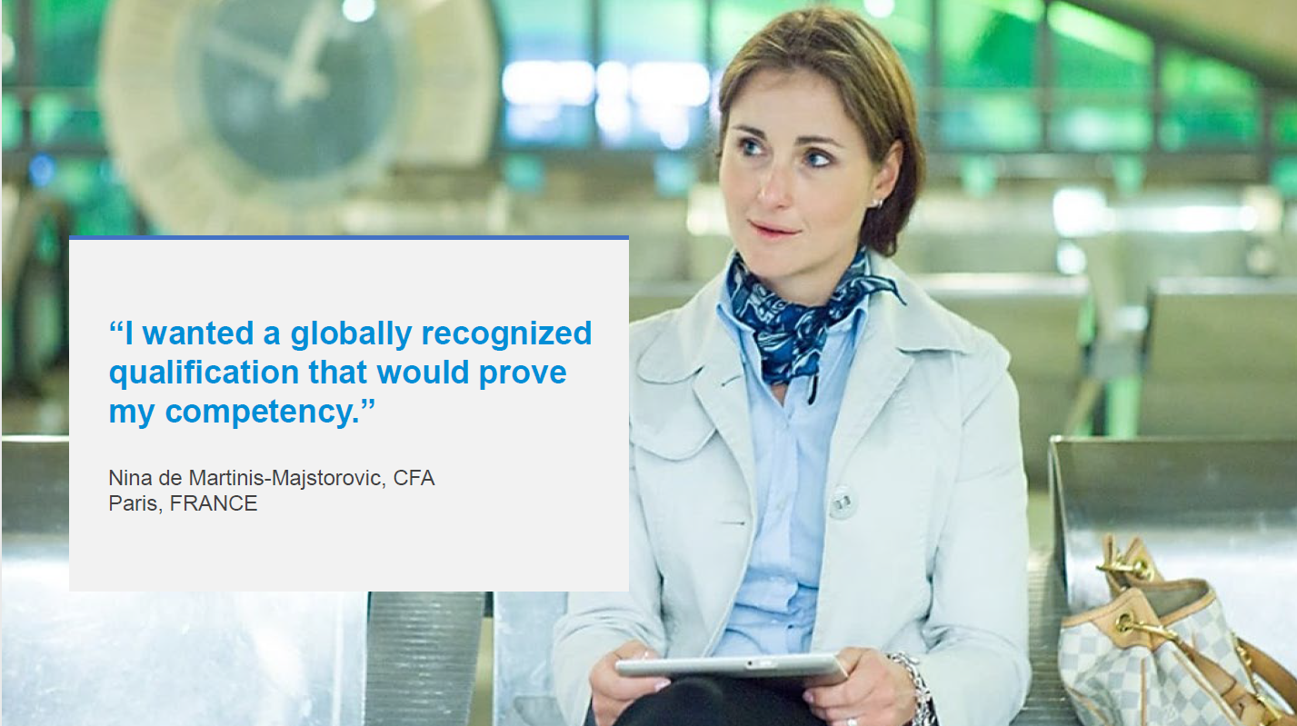

Slide 5
What is the CFA charter?
  Globally recognized professional designation
  Graduate-level investment credential
  Self-study program with three levels of examinations
  Curriculum focused on the practical knowledge and current real-world skills necessary in the global investment management profession
  Ethical and professional standards emphasized at every level
  Recognized by regulatory bodies in many countries as a proxy for meeting certain licensing requirements, as well as waiver for GRE or GMAT requirements for MBA programs, and credit towards other certification programs.
  https://www.cfainstitute.org/en/membership/benefits/waivers

Slide 6
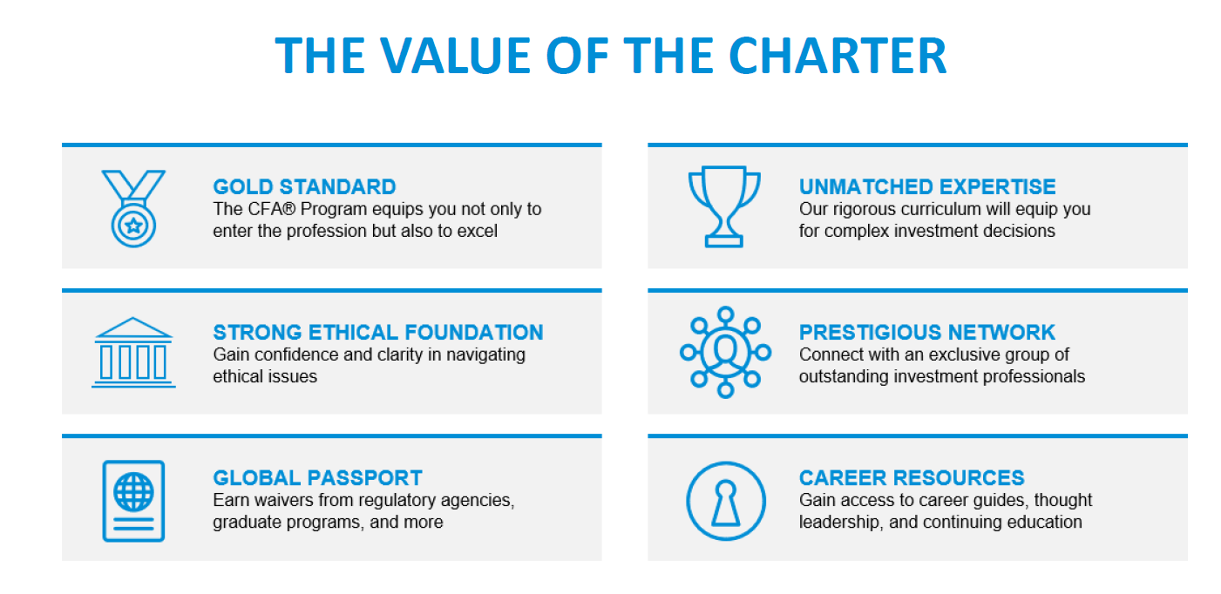

Slide 7
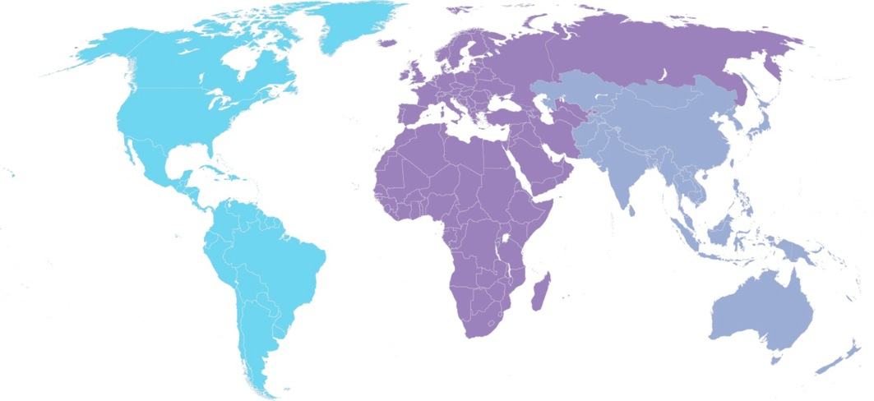
Membership, candidates & societies
More than 164,000 members in 166 countries; 151 member societies
60%
AMERICAS
Members: 95,798
CFA Program
Registrations: 87,954
Societies: 91
21%
EMEA
Members: 34,657
CFA Program
Registrations: 58,370
Societies: 40
19%
ASIA PACIFIC
Members: 29,694
CFA Program
Registrations: 172,865
Societies: 20

Slide 8
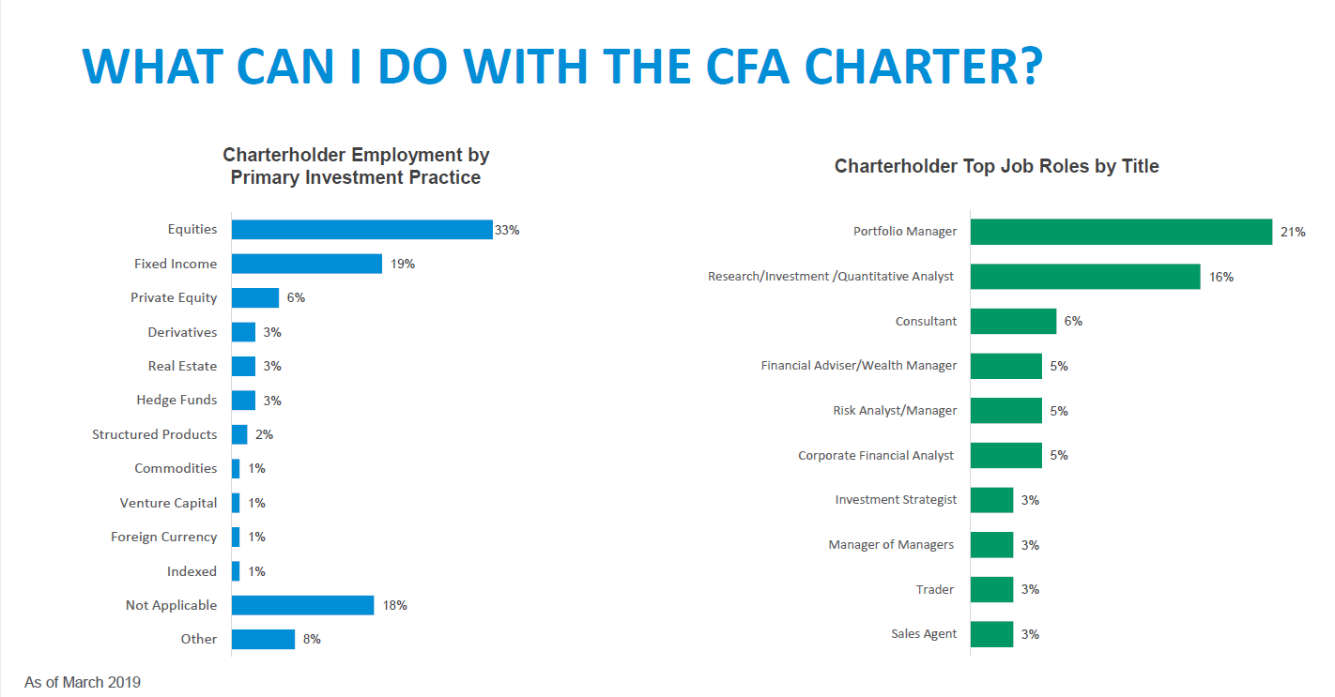

Slide 9
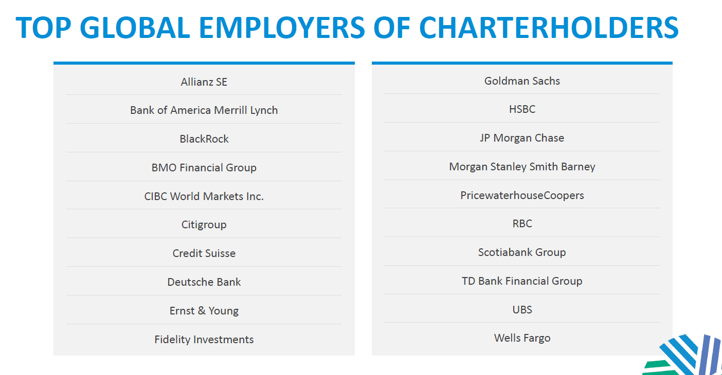

Slide 10
Employers seek out the cfa® charter
  “Working towards a CFA designation considered an asset”
  Investment Analyst Rotation Program, OMERS
  “Must have CFA”
  Portfolio Manager, BMO Private Banking
  “Bachelor’s degree required, with the pursuit of a CFA designation considered a plus”
  Associate, Infrastructure & Natural Resources, OTPP
  “Bachelor’s degree or equivalent related experience. MBA or CFA Preferred.”
  Managing Director, Corporate Finance, Silicon Valley Bank

Slide 11
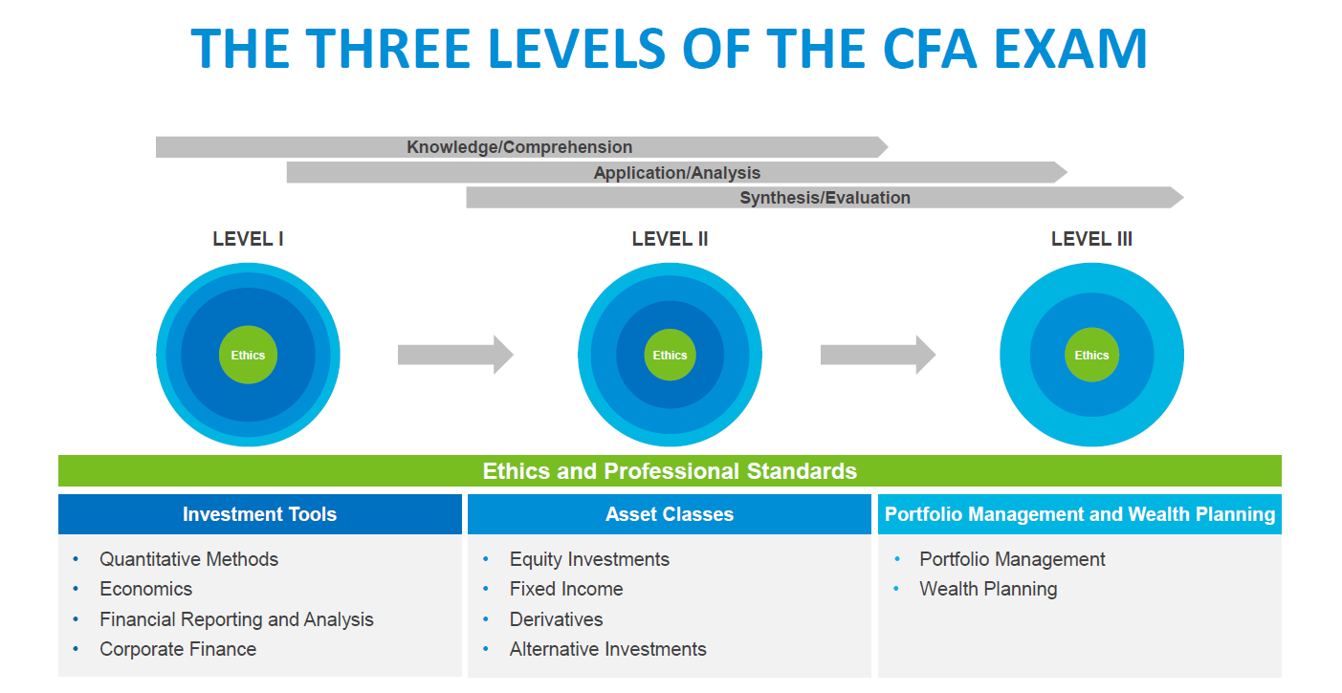

Slide 12
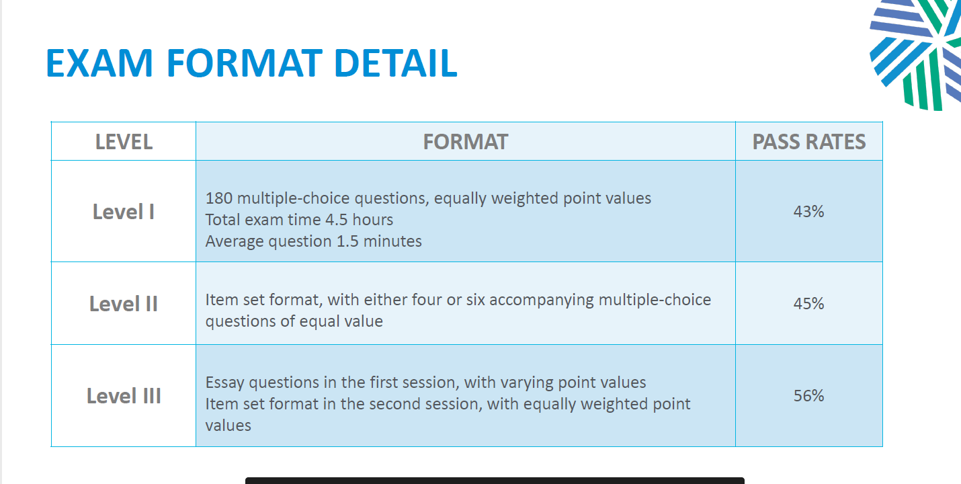

Slide 13
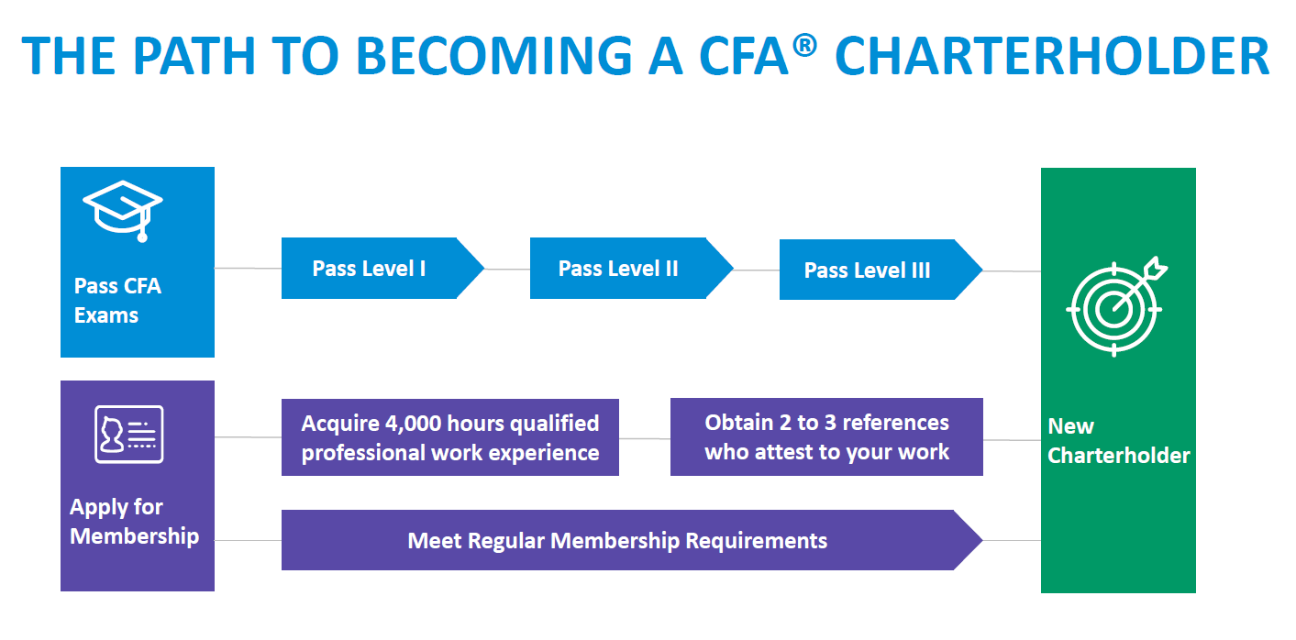

Slide 14
What you learn as a cfa® charterholder
CFA Topic Exam Area Weights
Ethical and Professional Standards
Quantitative Methods
Economics
Financial Reporting and Analysis
Corporate Finance
Equity Investments
Fixed Income
Derivatives
Alternative Investments
Portfolio Management and Wealth Planning
Level I
15%
10%
10%
15%
10%
11%
11%
6%
6%
6%
Level II
10-15%
5-10%
5-10%
10-15%
5-10%
10-15%
10-15%
5-10%
5-10%
5-15%
Level III
10-15%
0%
5-10%
0%
0%
10-15%
15%-20%
5-10%
5-10%
35-40%

Slide 15
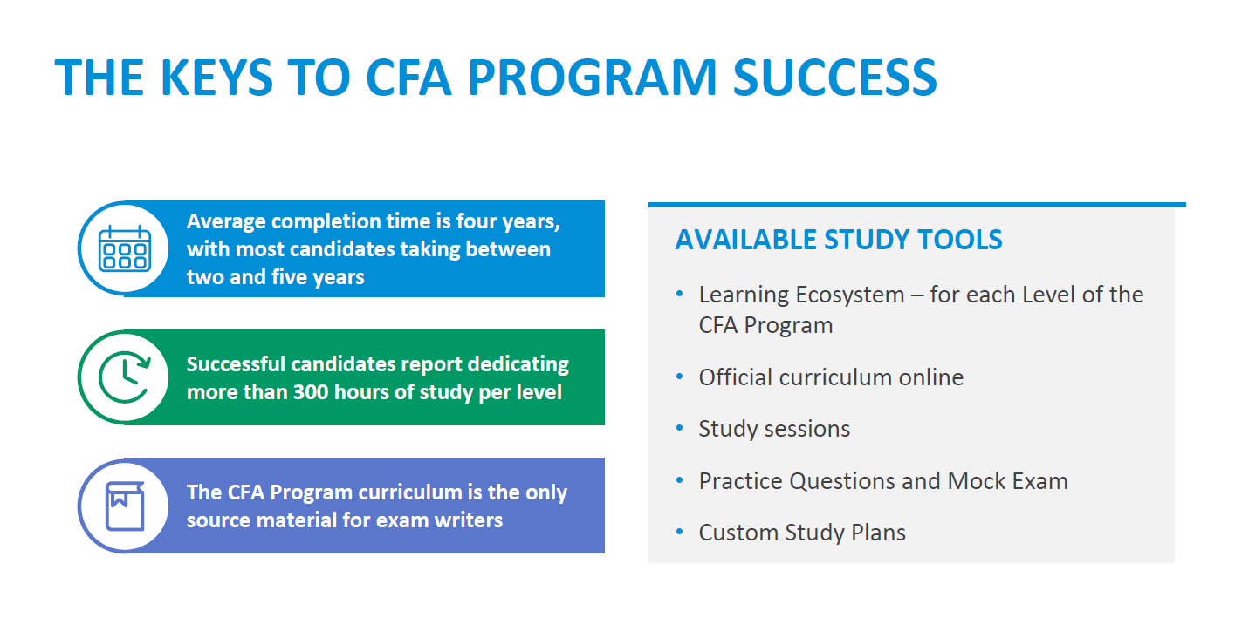

Slide 16
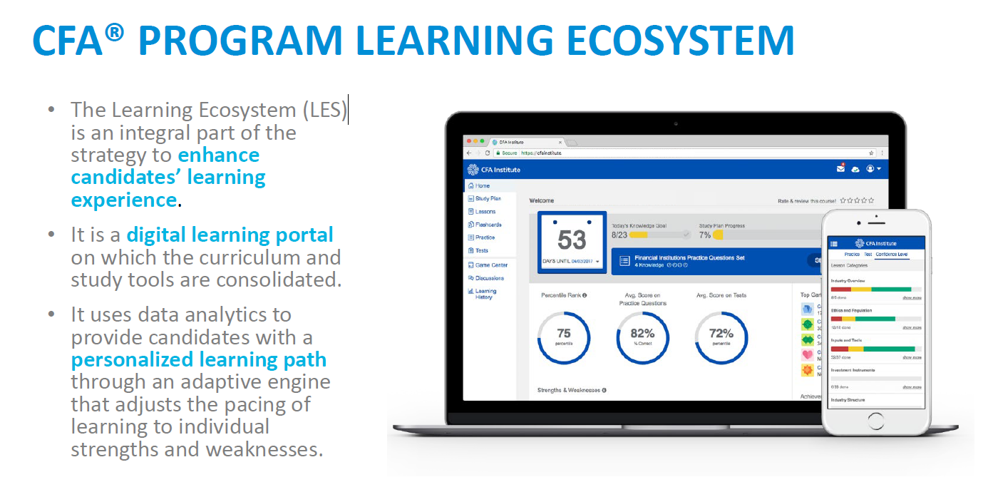
Notes:
https://www.cfainstitute.org/programs/learning-ecosystem

Slide 17
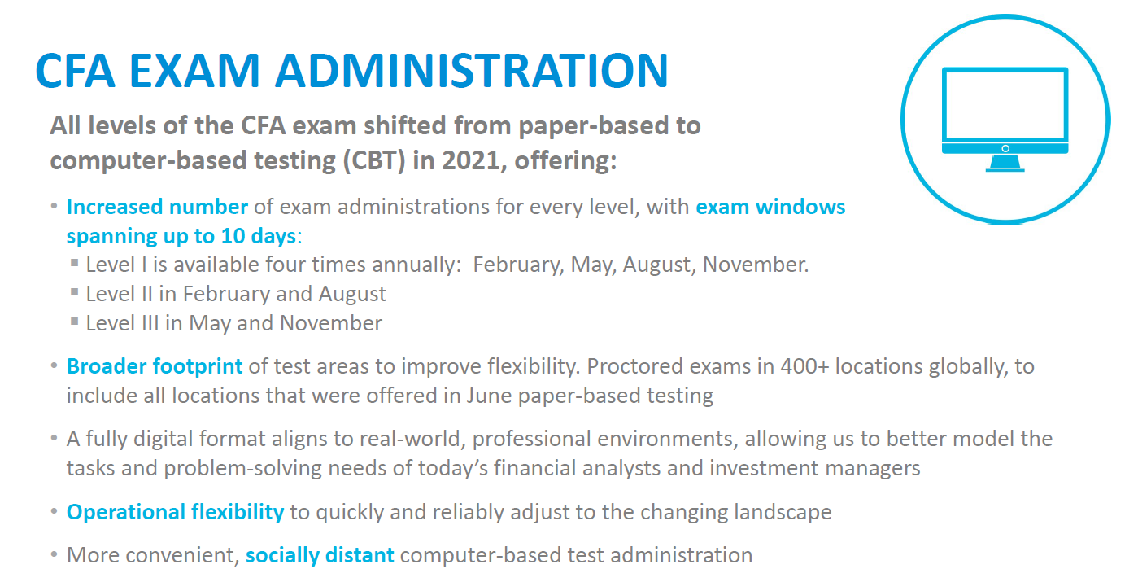

Slide 18
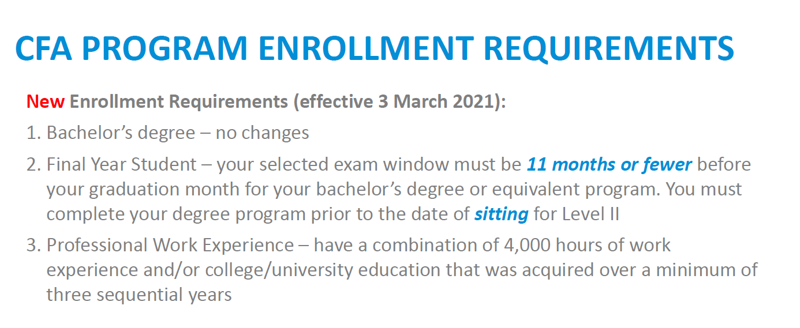
Please visit our website to view the full CFA Program enrollment requirements
and related FAQs

Slide 19
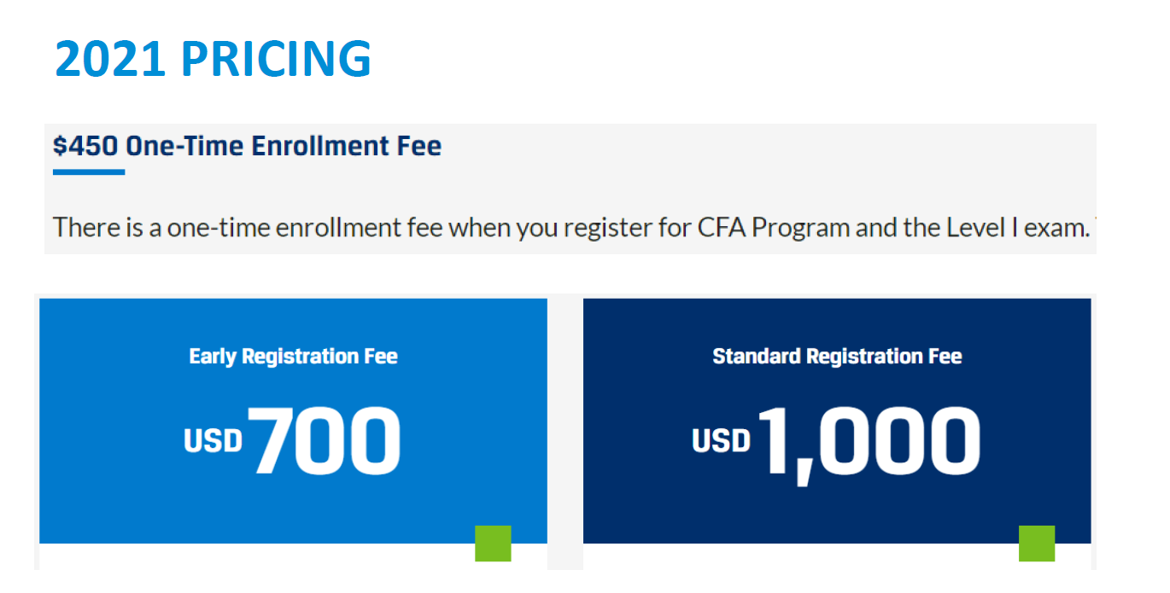

Slide 20
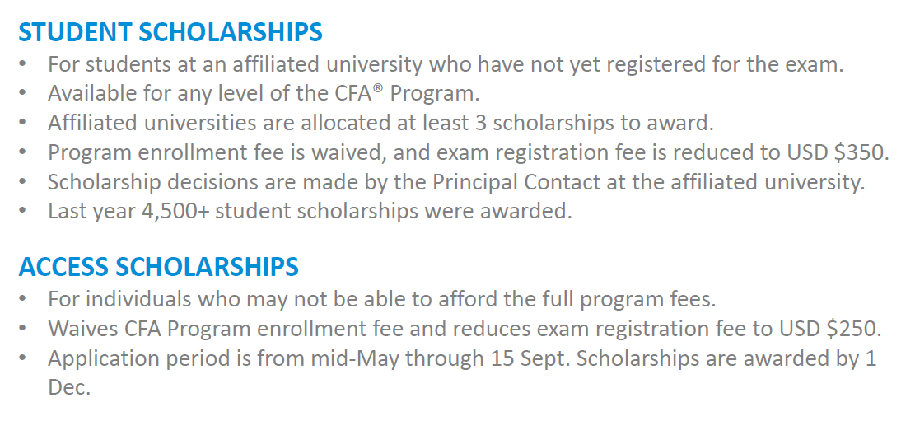
SCHOLARSHIPS
https://www.cfainstitute.org/en/programs/cfa/scholarships

Slide 21
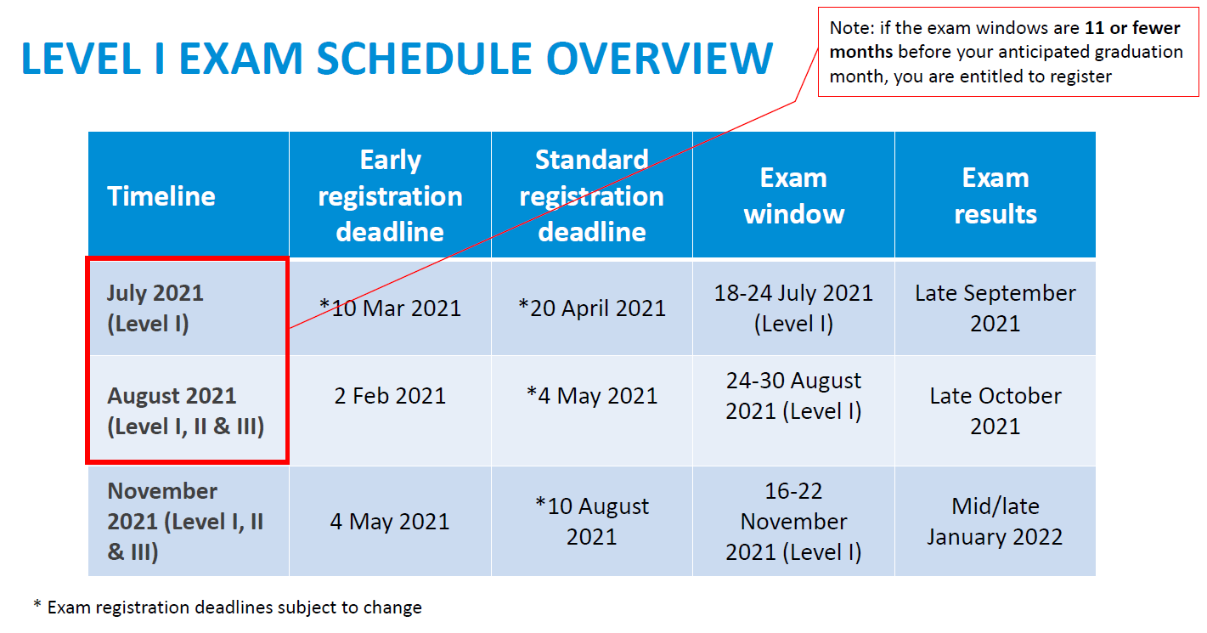

Slide 22
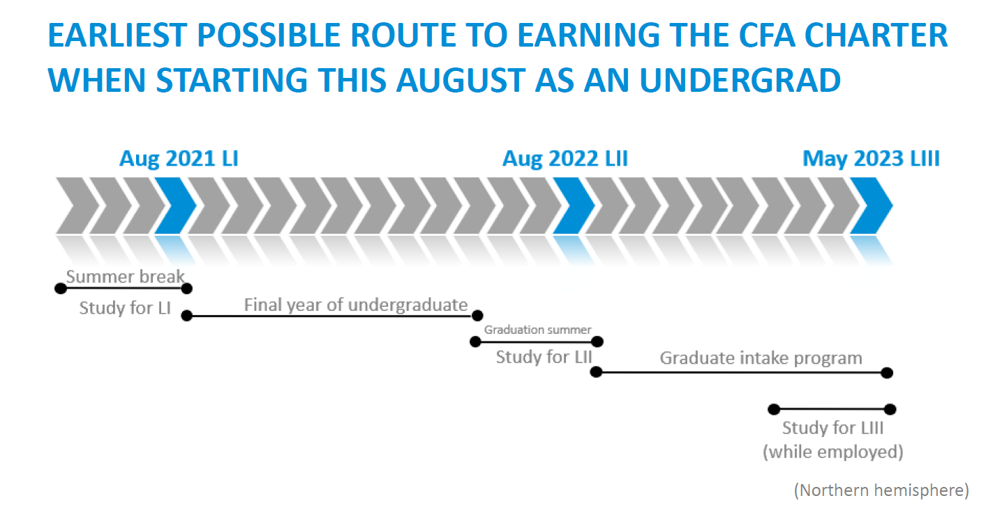

Slide 23
PATHING DIAGRAM

Slide 24
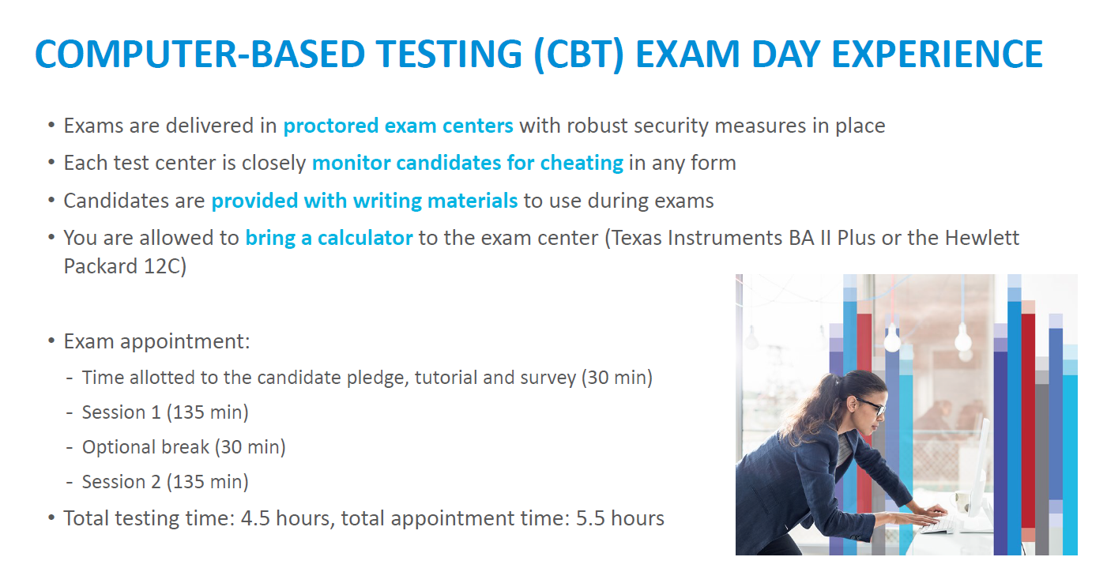

Slide 25
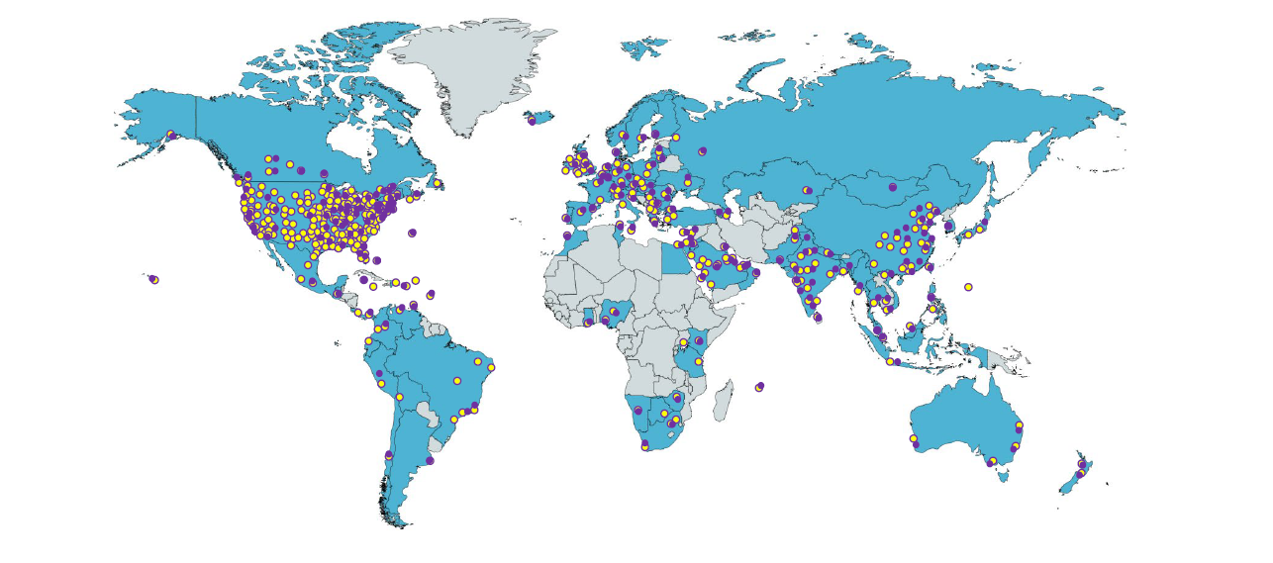
IN 2021 –WITH THE ADVENT OF COMPUTER-BASED TESTING – CFA Institute INCREASED the NUMBER OF CITIES SERVED FROM 192 TO 426

Slide 26
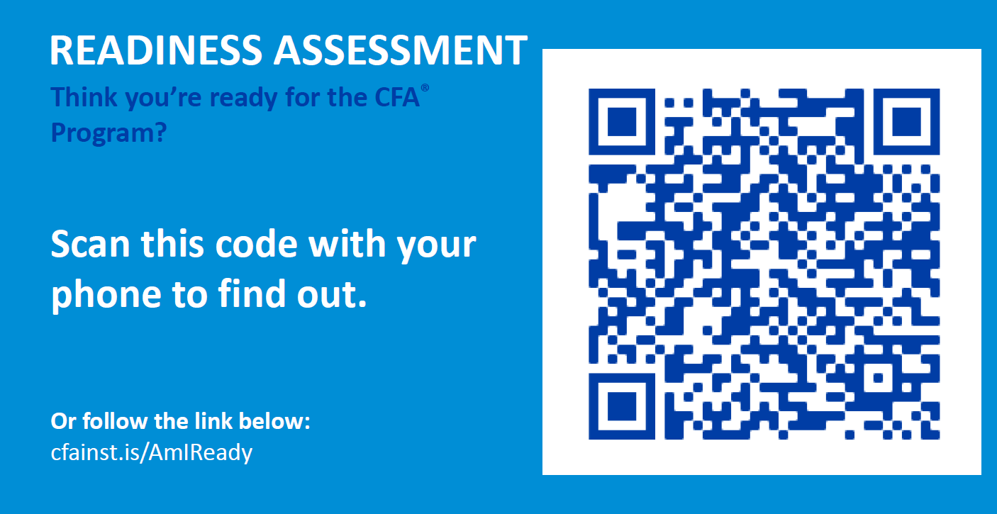

Slide 27
CFA Society Toronto
Conferences, Workshops, Seminars & Classes
cfatoronto.ca
Awards & University Relations Committee Programs
cfatoronto.ca/students
Notes:
CFA Society Toronto is Canada’s largest association of Chartered Financial Analysts and is ranked the second-largest CFA Society in over 150 global financial markets.

Slide 28
Become a member of CFA Society Toronto
Regular Membership
Pass the Level I exam, and
4,000 hours of qualified work experience*
Affiliate Membership
Pass the Level I exam, and
12 months of acceptable work experience
Associate Membership
Open to individuals who do not qualify for
Regular or Affiliate membership levels
* 4,000 hours qualified work experience completed in no less than 36 months
https://www.cfatoronto.ca/membership
Notes:
Access to CFA Society Toronto’s Career Centre
Connect with 10,000+ members (one of the top three largest CFA Societies in over 150+ global financial markets)
Continuing education seminars and workshops

Slide 29
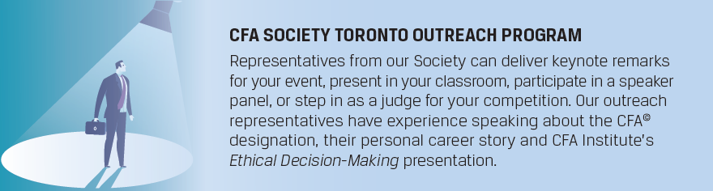
Keynote speaker
Speaker panel representative
Networking representative
Competition judge
Request Awards & University Relations Committee
Student Ambassadors as networking representatives for your events
https://www.cfatoronto.ca/universityoutreach

Slide 30
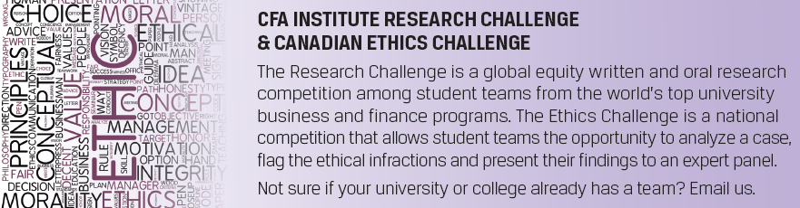
CFA Institute Research Challenge
CFA Society Toronto & CFA Society Ottawa Research Challenge Local Competition
An equity research competition, held annually, among student teams from the world’s top university business and finance programs. Students write an equity research report on a publicly traded company and present their findings to an expert panel. Throughout the competition, leading investment professionals volunteer as mentors and judges and teach the students best practices in equity research and corporate analysis.
https://www.cfatoronto.ca/researchchallenge
CFA Societies Canada Ethics Challenge
CFA Society Toronto Local Competition
The Ethics Challenge is designed to increase students’ awareness of the ethical dilemmas they may face as future investment management professionals. Student teams from finance or economics programs are given an ethics case to study and evaluate. Each team then presents its analysis and recommendations, to a panel of judges.
https://www.cfatoronto.ca/ethicschallenge

Slide 31
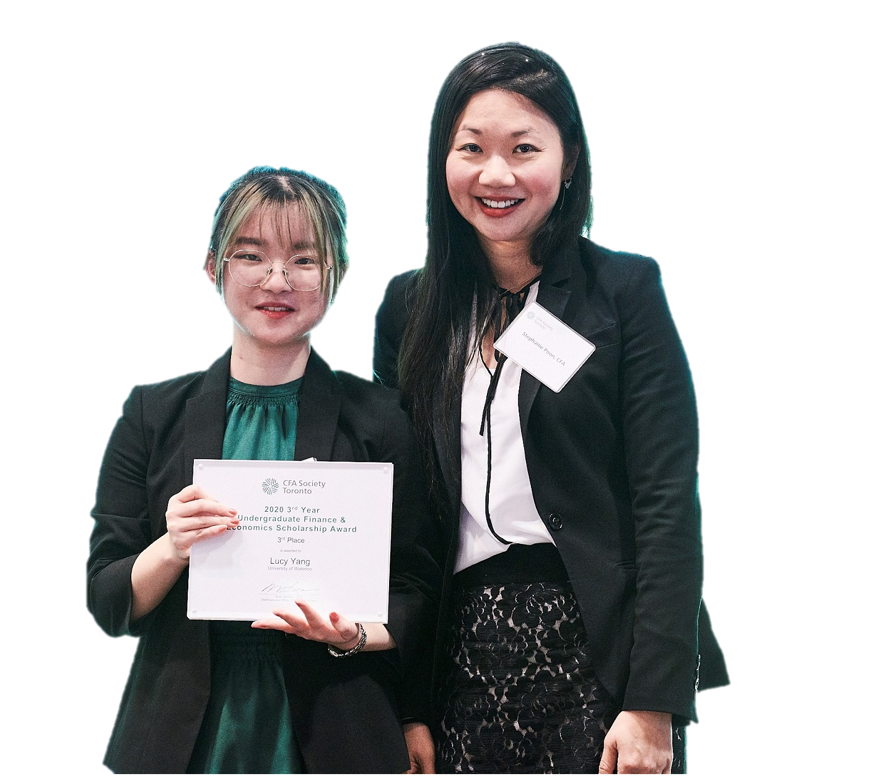
Awards
3rd and 4th year Undergraduate Scholarship Award
Three 3rd year and three 4th year scholarships. First place $3,000, second place $2,000 and third place $1,000 (CAD) are given to select candidates who are in their third- or fourth- year of finance and economic study and have a minimum 3.0 GPA (or equivalent) in their program.
Hillsdale Investment Research Award
Hillsdale Investment Management Inc. and CFA Society Toronto are committed to advancing the knowledge of investment management practices through the publication of quality academic and practitioner-relevant research. Submit your research paper for a chance to receive $10,000 CAD.
https://www.cfatoronto.ca/awards

Slide 32
Upcoming Events
Thu. April 1, 21 CFA Program and Career Insights Speaker Series (4)
Stephanie Poon, CFA
Vice President
RBC Capital Markets
For more details, please contact info@cfatoronto.ca

Slide 33
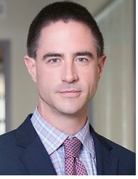
Brian Madden, CFA, CFP
Senior Vice-President & Portfolio Manager
Goodreid Investment Counsel

